Slide 1

DATABASE DESIGN & IMPLEMENTATION
Road Sign And Road Map Mobile Notification Application
Task 6
Group 5

Slide 2
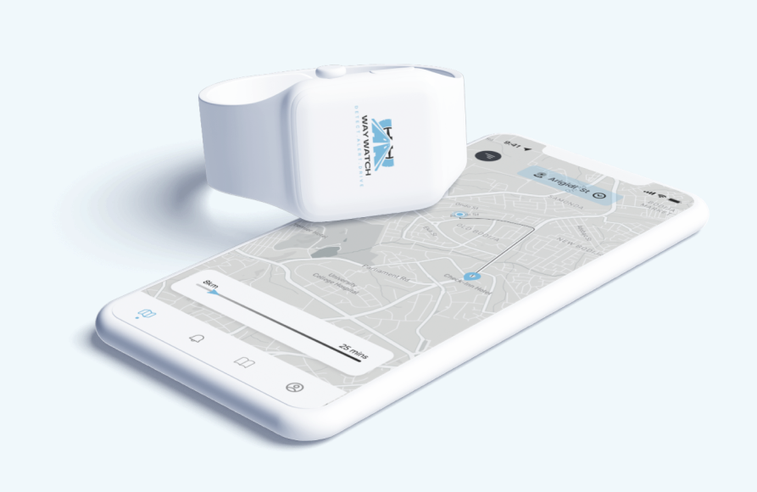
Introduction
This report presents the comprehensive backend system design and implementation for WayWatch, a mobile road management application that provides real-time road condition monitoring, incident reporting, and location-based services.

Slide 3

Design Design​ & & implementations Implementation Implementation

Slide 4
Design Principles
1 PostgreSQL with PostGIS
3
Geometry(Point, 43260)
5
Spatial Indexing
2 UUID Primary Keys
4
JSONB Data Types

Slide 5
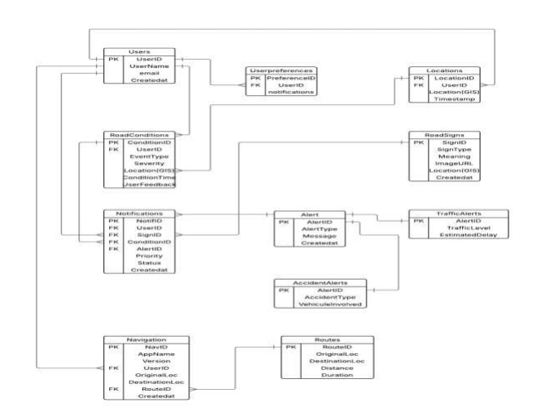
Entity – Relationship Diagram

Slide 6
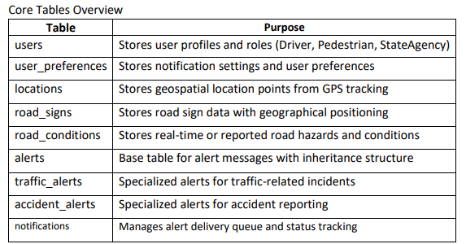
Schema Design & Relationship
The database schema comprises of 12 core tables:
Users
Users preferences
Locations
Road_signs
alerts

Slide 7
Security Measures
2
3
1
Data Validation
Access Control
Data Protection
Reliability Measures
1
2
3
Performance Monitoring
Data Integrity
Backup Recovery

Slide 8

back-end api back-end api back-end api implementation implementation implementation implementation

Slide 9
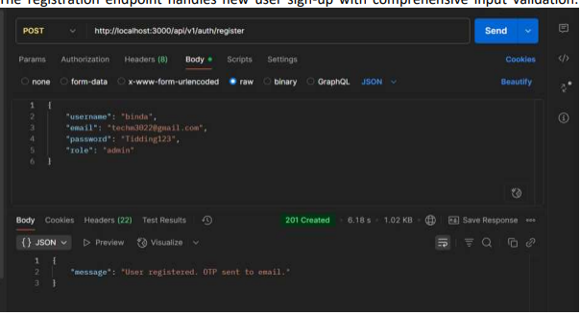
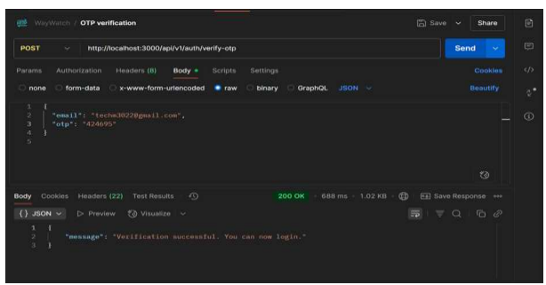
User Authentication System & OTP Verification

Slide 10
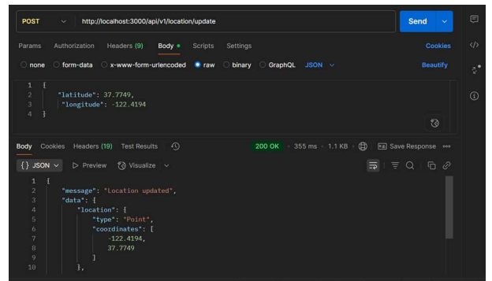
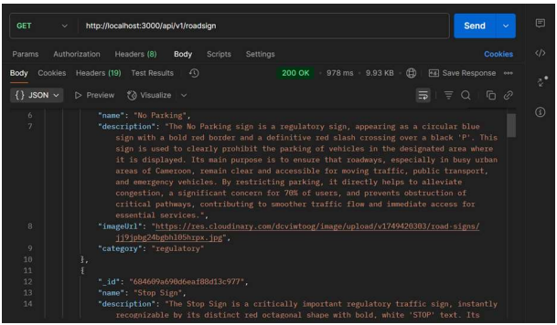
Location Service & Road Sign Management

Slide 11
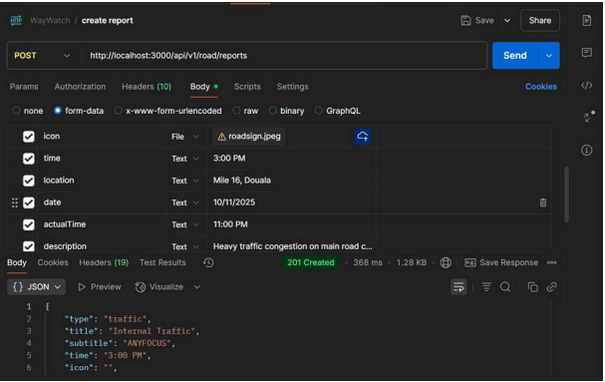
Crowd Reporting & Alert Notification

Slide 12
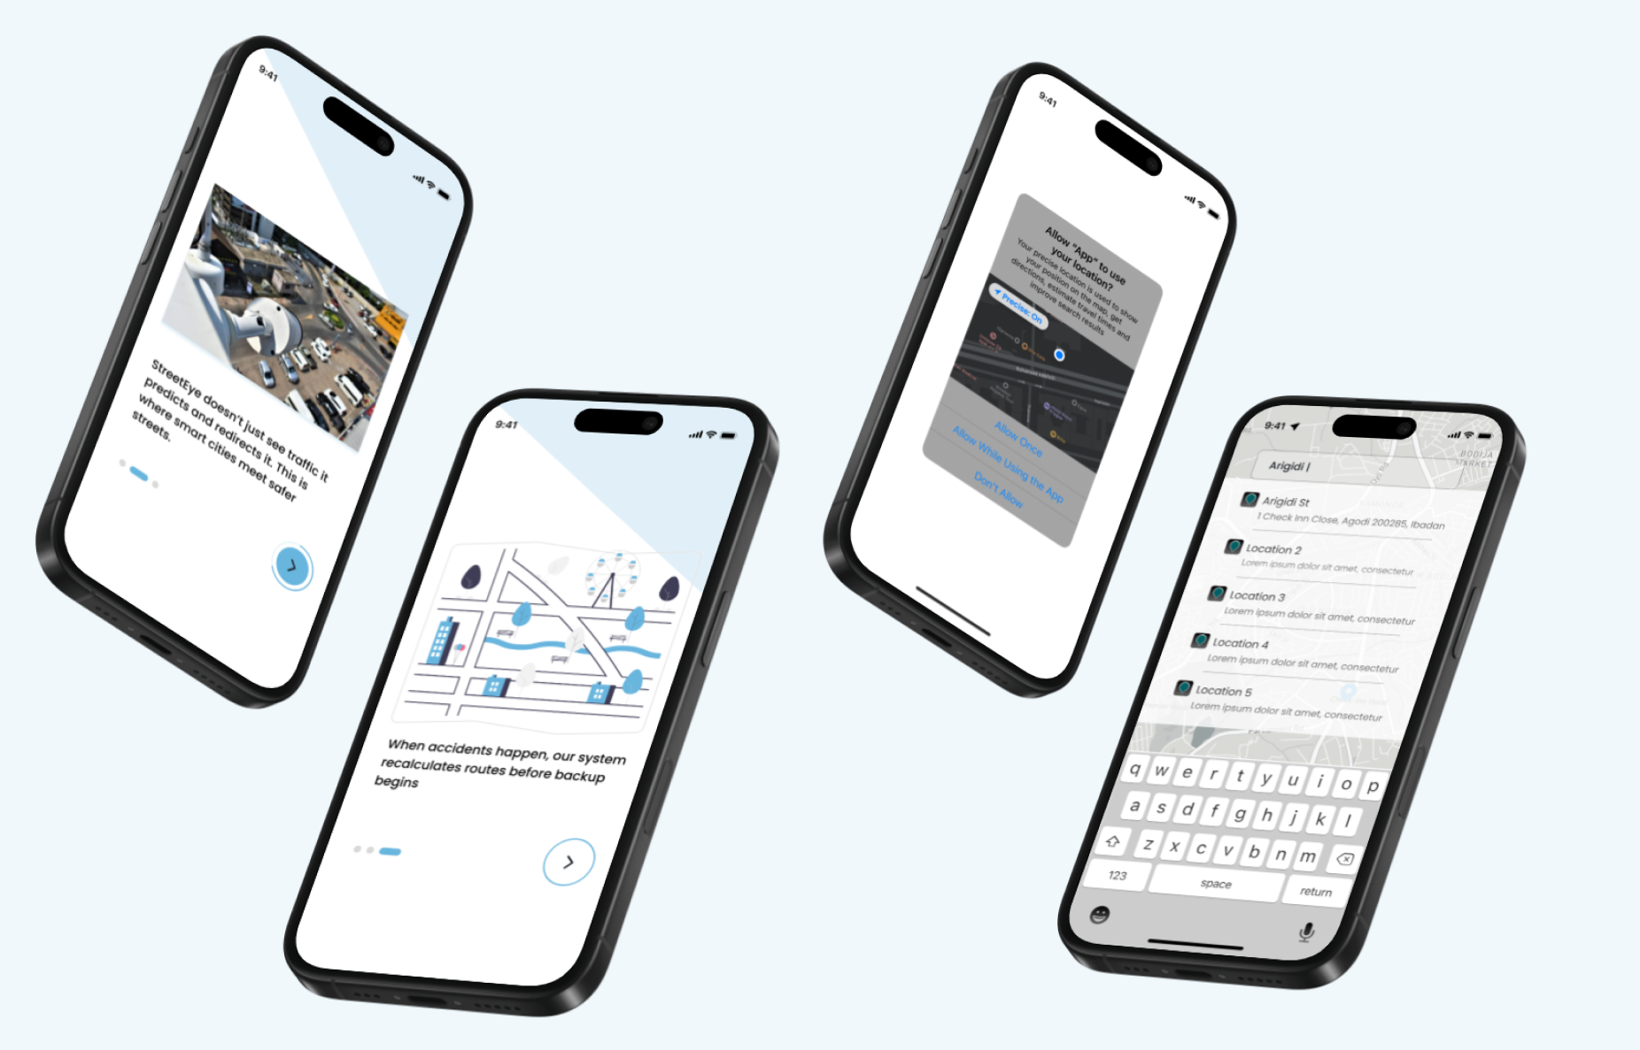
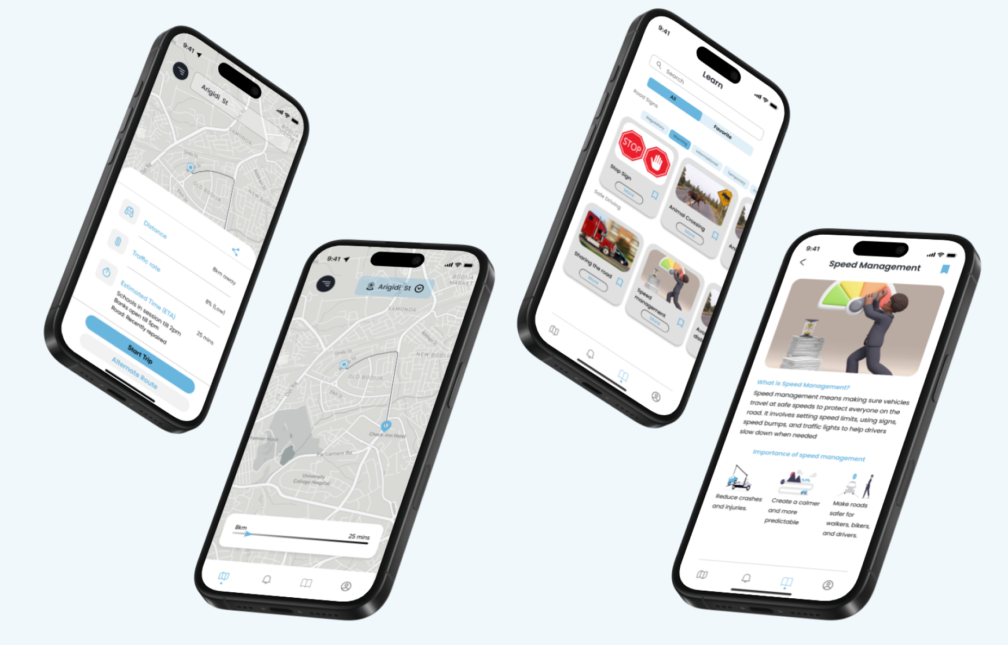

Slide 13
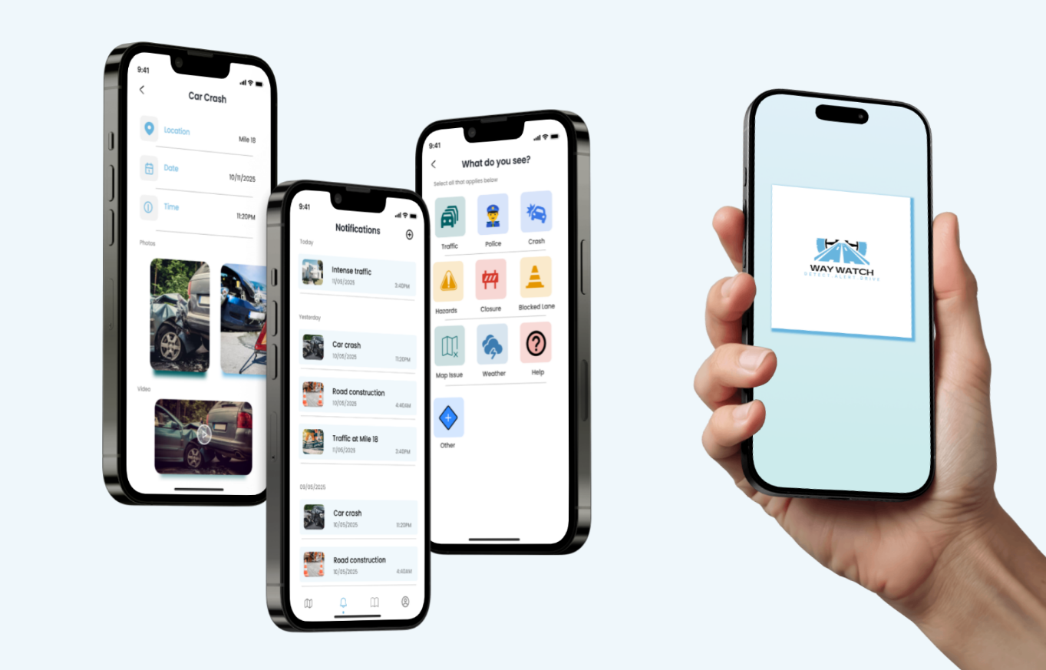

Slide 14

Thank You

